Slide 1




prioritizr Systematic conservation planning in R R
Richard Schuster & Jeffrey Hanson
jeffrey.hanson@uqconnect.edu.au
prioritizr.net

Slide 2

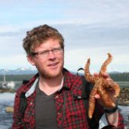

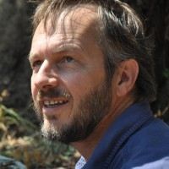
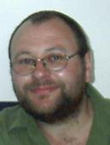
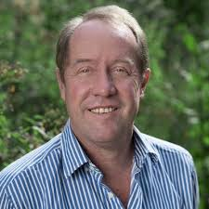
Acknowledgements
Matt Strimas-Mackey
Nina Morrell
Matt Watts
Joe Bennett
Peter Arcese
Hugh Possingham

Slide 3
How should $we
$manage $areas to
$achieve
$conservation?

Slide 4






Slide 5
Objective
Maximize number
of populations
in reserves,
subject to budget?

Slide 6
Objective
Maximize number
of threatened
populations in
reserves,
subject to budget?

Slide 7
Objective
Maximize
phylogenetic
diversity in reserves,
subject to budget?

Slide 8
Objective
Minimize cost,
subject to targets to
ensure adequate
representation
in reserves?

Slide 9
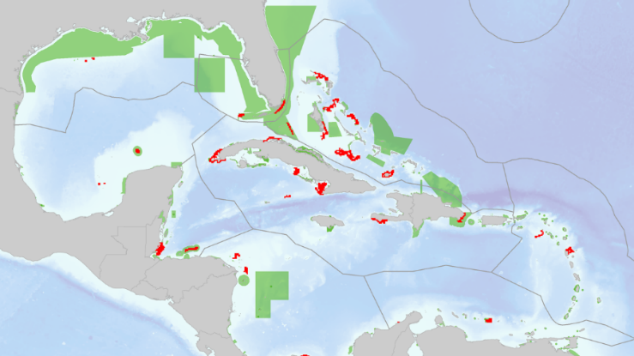
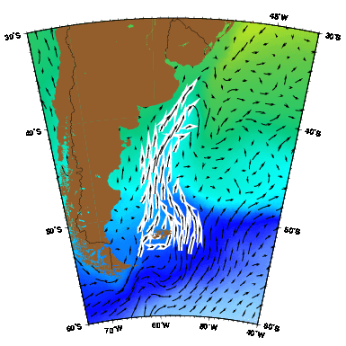
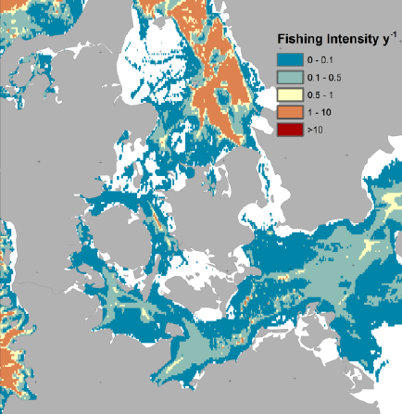
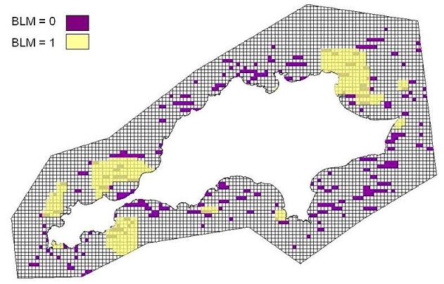
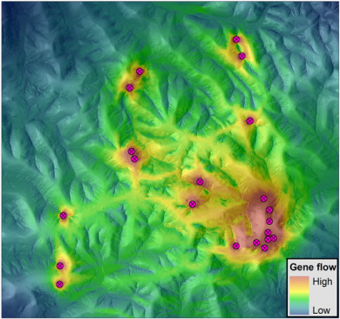
Constraints and Penalties

Slide 10
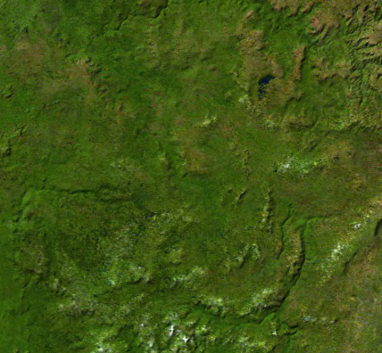
Decision type
Protect or not?
Different amounts?
Multiple actions?

Slide 11





Solver
?
?
?
?

Slide 12

prioritizr
Design your problem
Find optimal solutions
Ideally, fast!

Slide 13
Design your problem
Mental model
problem <- data +
objective +
constraints +
penalties +
decision type +
solver
solution <- solve(problem)

Slide 14
Design your problem
Mental model
Code
problem <- data +
objective +
constraints +
penalties +
decision type +
solver
solution <- solve(problem)
p <- problem(pus, feats) %>%
add_min_set_objective() %>%
add_relative_targets(….) %>%
add_boundary_penalties(….) %>%
add_binary_decisions() %>%
add_rsymphony_solver()
solution <- solve(p)

Slide 15
Design your problem
Objectives
add_max_features_objective
add_max_phylo_objective
add_max_utility_objective
add_min_set_objective
Penalties
add_connectivity_penalties
add_boundary_penalties
add_feature_weights
Decisions
add_bindary_decisions
add_proportion_decisions
add_semicontinuous_decisions
Constraints
add_feature_contiguity_constraints
add_contiguity_constraints
add_locked_in_constraints
add_locked_out_constraints
add_neighbour_constraints
Solvers
add_gurobi_solver
add_lpysmphony_solver
add_rsymphony_solver

Slide 16
Design your problem
problem(pu, fts, "cost") %>%
add_min_set_objective() %>%
add_relative_targets(…) %>% add_binary_decisions() %>%
solve()
Single zone
problem
problem(pu, zones(fts_z1, fts_z2, …),
c("cost_1", "cost_2", …)) %>%
add_min_set_objective() %>%
add_relative_targets(…) %>% add_binary_decisions() %>%
solve()
Multi-zone
problem

Slide 17
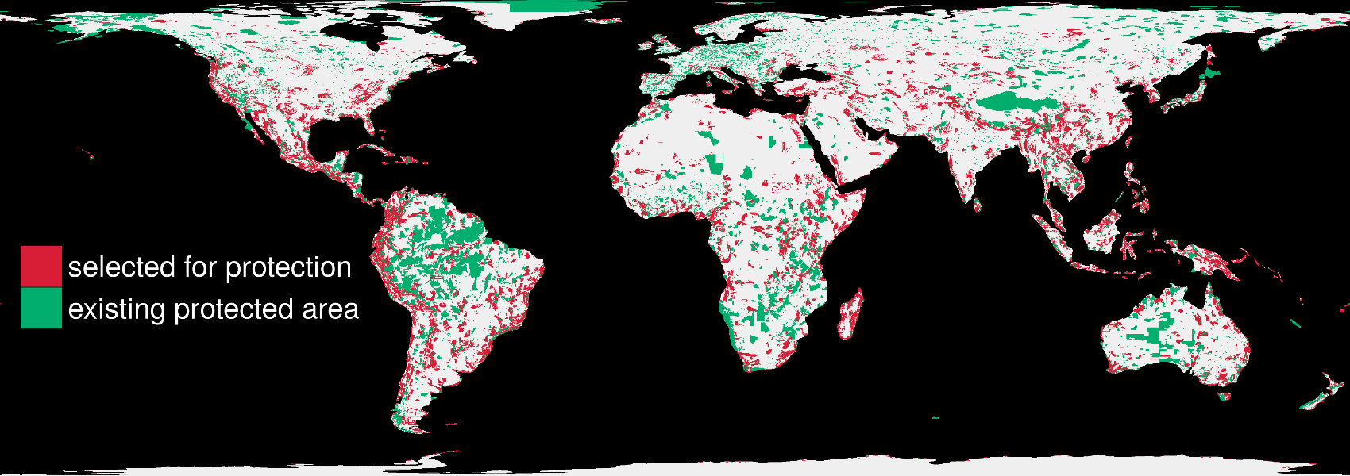
Find optimal solutions, ideally fast
1.5 million planning units + 22,644 species: 76 minutes

Slide 18
Insert Richard’s slides here

Slide 19


richard.schuster@glel.carleton.ca
jeffrey.hanson@uqconnect.edu.au
prioritizr.net

